Slide 1


Accenture
Social Buzz Data Analysis

Slide 2


Today's agenda
Project recap
Problem
The Analytics team
Process
Insights
Summary

Slide 3


Social Buzz is a fast growing technology unicorn that need to adapt quickly
To its global scale . Accenture has begun a 3 month POC focusing on this tasks:
An audit of Social Buzz’s big data practice.
Recommendations for a successful IPO.
Analysis to find Social Buzz’s top 5 most popular categories of content.
Project Recap

Slide 4


Problem
Over 100000 Posts Per Day.
36,500,000 Pieces of Content Per Year!
But when to capitalize on it when there is so much?
Analysis to find social Buzz top 5 most popular content categories.

Slide 5



Marcus Rompton
Chief Technical Architect
The Analytics team
Andrew Fleming
Senior Principal
Mahendra Ballal
Data Analyst

Slide 6

Process
1
Data Understanding
2
Data Cleaning
Data Modelling
3
4
Data Analysis
5
Insights

Slide 7

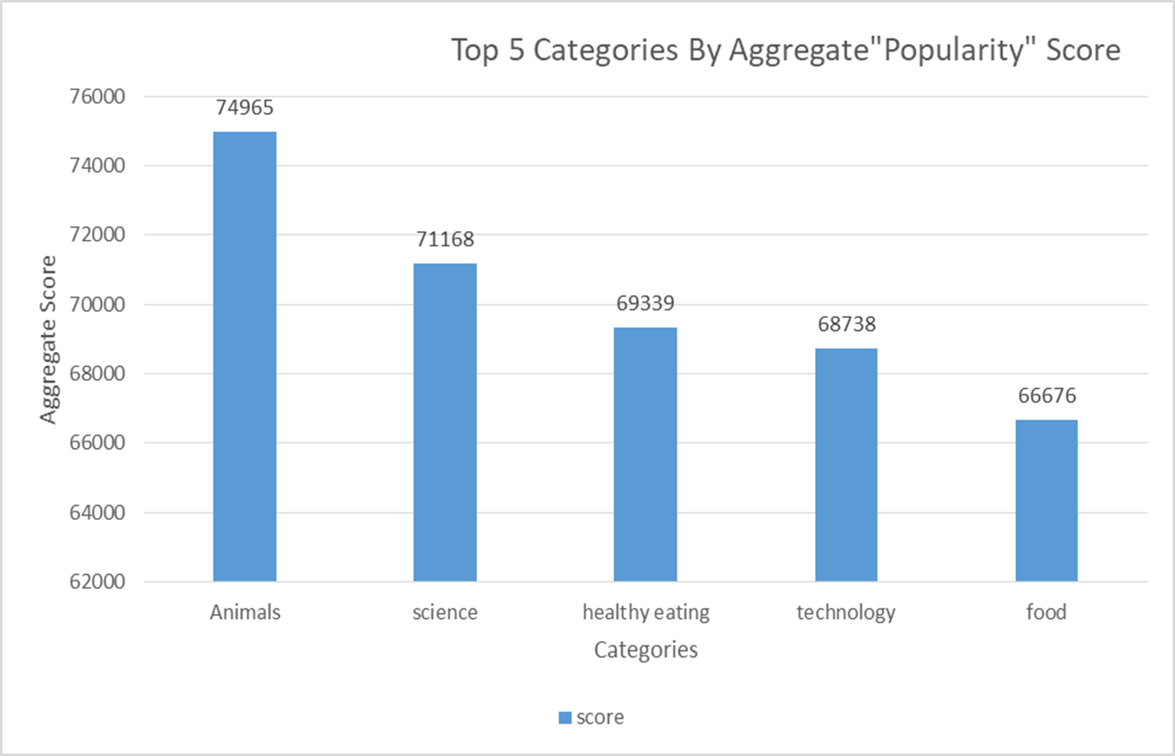

Slide 8
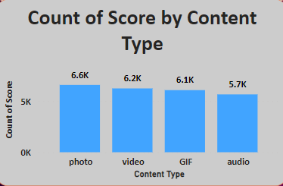

Slide 9
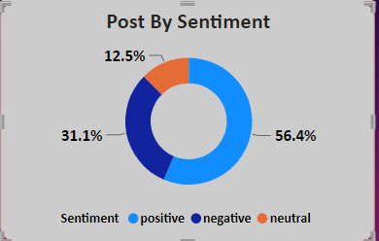

Slide 10
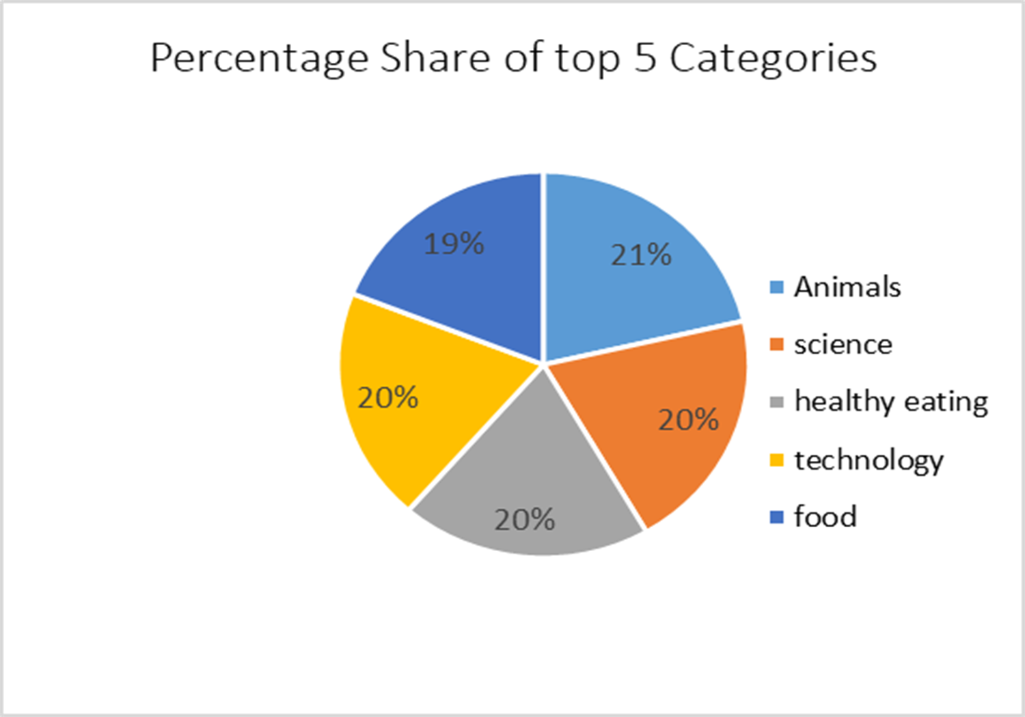

Slide 11
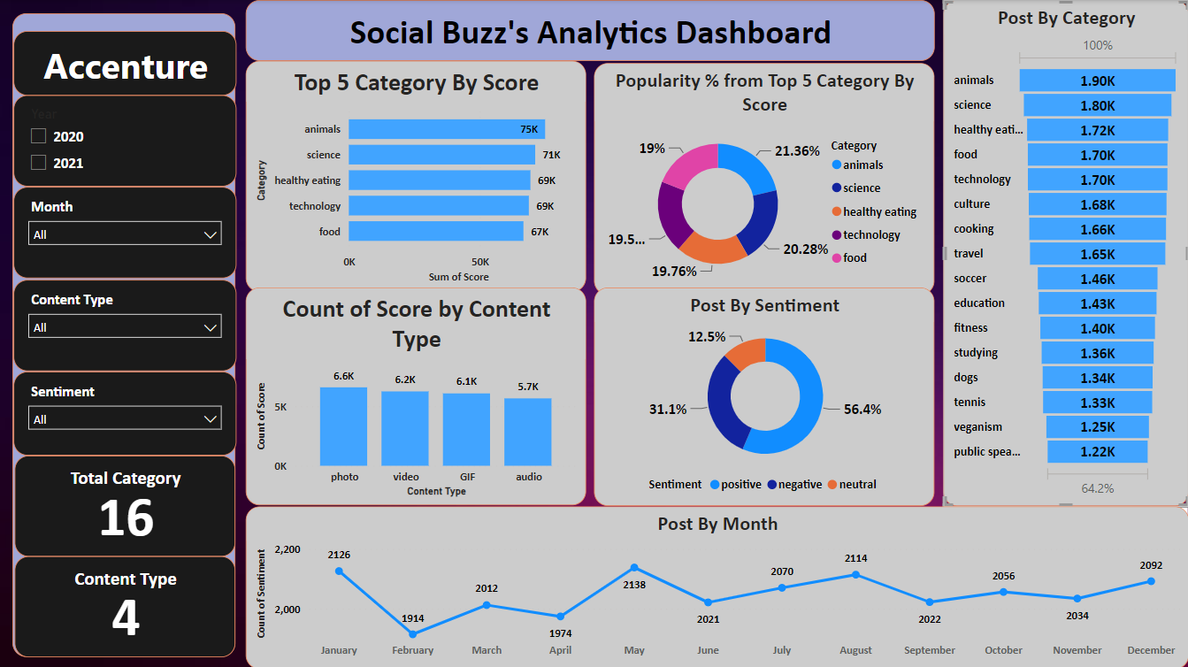

Slide 12

Insights
16
Unique Categories
1897
Reactions to “Animal” Posts
January Month with Most Post

Slide 13


Analysis
Animal and science are two most popular categories of content, showing that people enjoy “real-life” and “factual” content the most. Photos are the posted most in social buzz.
Insight
Food is common theme with the top 5 categories with “Healthy Eating” ranking the highest.
This may give an indication to the audience within your user base.
You could use this insight to create a campaign and work with healthy eating brands to boost user engagement.
Next Steps
Taking our analysis into large scale production for real time understanding of our business will undoubtedly provide valuable insights and help us make more informed decisions. We can show you how to do this.
Summary

Slide 14

Thank you!
ANY QUESTIONS?

